Slide 1

Advanced Computing Concepts COMP8547-1-R-2022S
FINAL PROJECT: DISCOVERY SEARCH ENGINE
Professor: Dr. Mahdi Firoozjaei

Slide 2

Team Members
Simran Arora - 110035535
Anureet Kaur - 110074496
Harmanjot Singh - 110089927
Suparno Bhatta - 110087785
Jay Modi - 110088536

Slide 3









What is a Search Engine?
A search engine is a software system that is designed to process website searches.
It is searched in the World Wide Web (WWW) in a systematic and methodical way for precise information itemized in a textual web query search.
The search results are often displayed in a line of results, also called as search engine result pages.
Ex: Google, Bing, WolframAlpha, Ecosia, Yandex, etc…

Slide 4

Incorporated Features
Web Crawler
Regular Expression
Spell checker
Inverted Index
Frequency Counter
Ranking Web Pages

Slide 5

Web Crawler

Slide 6
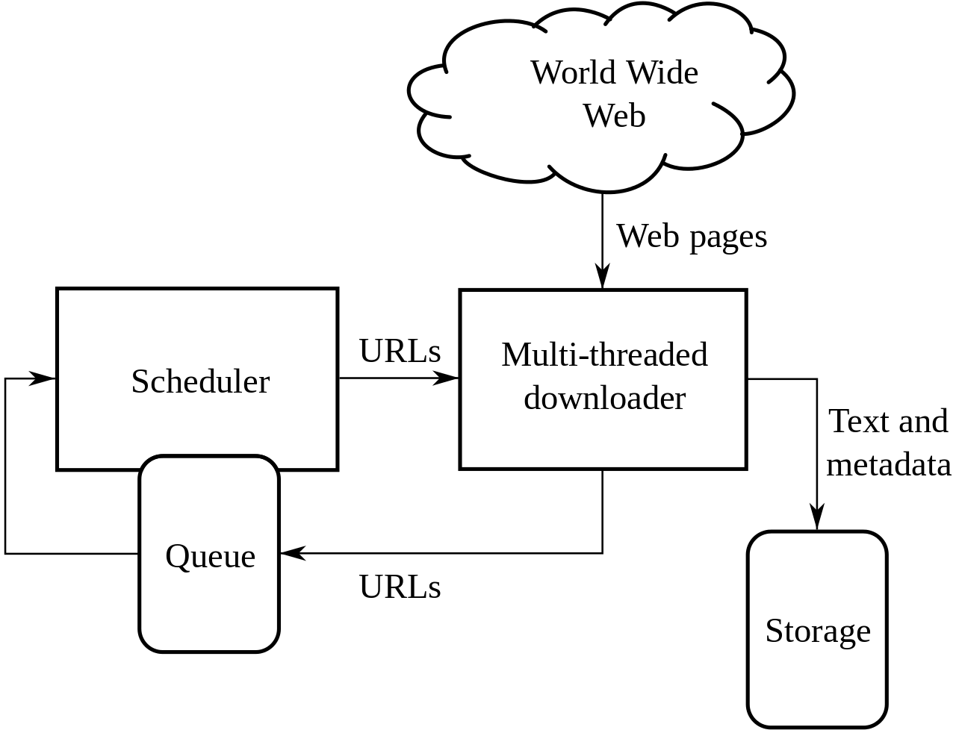
Web Crawler
A web crawler, spider, or search engine bot downloads and indexes content from all over the Internet.
The goal of such a bot is to learn what almost every webpage on the web is about, so that the information can be retrieved when it's needed.
They are called "web crawlers" because crawling is the technical term for automatically accessing a website & obtaining data via a software program.
By applying a search algorithm to the data collected by web crawlers, search engines can provide relevant links in response to user search queries, generating the list of webpages that show up after a user types a search into any search engine.
Architecture of a Web Crawler

Slide 7
How does a WEB CRAWLER work?
The primary domain link will be provided
Searches for all the sublinks on the WEB for that domain
Fetches all the URLs in that domain within a given range of max_depth and max_num_urls needed
Stores all those URLs in a text file

Slide 8

Regular Expression
This feature allows to the sequence of characters that specifies a search pattern in a text

Slide 9
Regular Expression
Regular expressions can be used to perform all types of text search and text replace operations.
Java does not have a built-in Regular Expression class, but we can import the java.util.regex package to work with regular expressions.
The package includes the following classes: Pattern Class - Defines a pattern (to be used in a search)Matcher Class - Used to search for the patternPatternSyntaxException Class - Indicates syntax error in a regular expression pattern

Slide 10

Spell Checker using Keyword Extraction
This feature extracts words from the text files omitting any special characters and irrespective of the case sensitive, followed by storing in a hash map

Slide 11

How does KEYWORD EXTRACTION work?
Hash and Tries are used used to store extracted keywords from the text file
Regex pattern is used to only read alphanumeric characters
The generated trie is stored in a dat file for faster access by the search engine

Slide 12
Inverted Index
An index data structure known as an inverted index stores a mapping between information, such as words or integers, and their places inside a single document or a collection of documents.
To put it simply, it's a data structure that looks like a hashmap that map words to its position in the documents.

Slide 13

Advantages : Inverted Index
The purpose of the inverted index is to enable fast full text searches at the cost of more processing when a document is added to the database
It is east to development
It is the most widely used data structure in document retrieval systems on a large scale , for example : in search engines

Slide 14
Disadvantages : Inverted Index
Large storage overhead and high maintenance costs on update, delete and insert.

Slide 15

Frequency Counter
Keyword frequency, which is also called keyword density, refers to the number of times a search term appears on a piece of content.
Finding the right keyword balance is an important part of your search engine optimization strategy.
If your content doesn’t have enough keywords, you might have trouble ranking on search engine results pages, especially when you’re using competitive keywords.
On the other hand, if your content contains too many keywords, it might get you in trouble

Slide 16
Why count the frequency keyword use?
The simple answer is you want to make sure you’re not creating spammy content which is stuffed full of keywords. Keyword stuffing can have a heavy impact on your SEO efforts.
The dangers of keyword stuffing include:
It can cause Google to hit you with a penalty.
It can cause problems with your site dropping in rankings.
It can cause you to lose visitors from spammy looking content.

Slide 17
Why Does It Matter?
Google and other search engine algorithms are smarter than ever before. Part of their job is to ensure that web pages provide relevant and valuable content for people.
Calculating and testing the keyword frequency of your content will help you prevent over-optimization and under-optimization.
Here are a few reasons why you need to calculate your content’s keyword frequency:
Ensure your visibility - The number of keywords you add to a web page or a paid ad will affect its visibility. It determines how well search engines will be able to find your content. In turn, it affects how well people will be able to find you organically.
Improve user experience - Adding too many unnecessary keywords hurts the user experience. You can improve it by creating high-value content and sprinkling relevant keywords throughout the page. In turn, you can reduce bounce rates and drive conversions.
Boost search rankings - Google values user experience more than the number of search queries on a page. Knowing how to calculate your keyword frequency enables you to avoid keyword stuffing.
Avoid penalties - Checking your keyword usage will help you avoid Google penalties, which may include ranking demotions or the full removal of your content from search listings.

Slide 18

Page Ranking
This feature ranks the web page based on the frequency of the words

Slide 19

How does PAGE RANKING work?
Pages are ranked on the URL index and occurrence of the words
Max Heap implementation is used for ranking web pages
Priority queue is used to implement max heap

Slide 20

GITHUB LINK
https://github.com/jaybmodi/SearchEngine.git

Slide 21

Future Scope
We are planning to implement a web-based and mobile based android application for the search engine
We are also planning to include GUI to improve User Experience
In functionalities, we would want to connect the database with the application which can store the user search history and rank web pages based on the user history
We also want to include more regex options for customized search

Slide 22
Roles & Responsibility
ANUREET KAUR – Ranking Web Pages
SIMRAN ARORA – Spell Checker
HARMANJOT SINGH – Finding Keywords using inverted index
SUPARNO BHATTA – Web Crawling & Frequency Counting
JAY MODI – Finding patterns using Regex

Slide 23

Conclusion
We have successfully developed the web search engine in Java using a plethora of concepts taught to us by Dr. Mahdi Firoojaei and assisted by Bahareh Rahmatikargar
At the end of the course, we are glad that we learnt about advanced topics in principles and applications of algorithm design and analysis, programming techniques, regular expressions, grammars, computing and intractability

Slide 24
References
https://en.wikipedia.org/wiki/Search_engine
https://en.wikipedia.org/wiki/Web_crawler
https://www.cloudflare.com/en-ca/learning/bots/what-is-a-web-crawler/
https://medium.com/nerd-for-tech/keyword-extraction-applications-and-tools-193ff7758cc7
https://towardsdatascience.com/keyword-extraction-with-bert-724efca412ea
https://www.semrush.com/blog/pagerank/

